Slide 1
Department of Public Health Measles Update
Anna Kathryn Burch, MD
Communicable Disease Epidemiology Section
August 5, 2025

Slide 2
Outline
Brief review of measles clinical presentation and diagnosis
Review epidemiology of measles in SC and USA
Review notification steps and response steps
Overview of September 2024 and 2025 measles case in SC

Slide 3
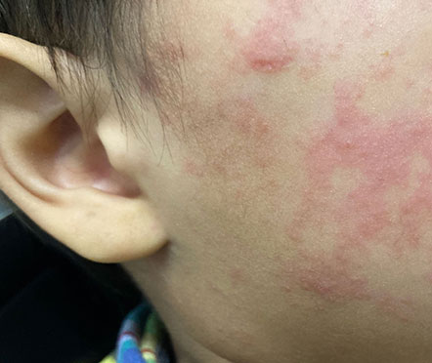
Measles Overview
Acute, febrile rash illness caused by the measles virus – paramyxovirus (RNA)
Transmitted via direct contact with infectious droplets or airborne route
Measles is highly contagious
  90% of susceptible contacts will develop the illness
  Single case will infect 12-16 people in an unvaccinated population
Incubation period 11 to 21 days
Measles rash
Source: CDC Pink Book, Chapter 13: Measles

Slide 4
Measles progression
Prodrome
  Lasts 2-4 days
  Fever (up to 105ºF)
  Cough, Coryza, and Conjunctivitis (the three “C’s”)
  Enanthem (Koplik spots)
Rash
  Occurs after prodrome
  Of at least 3 days
  Maculopapular
  Spreads from head to trunk to extremities
  May become confluent
  Last 5-6 days and fades in order of appearance
Source: CDC Pink Book, Chapter 13: Measles

Slide 5
Measles complications
Complication* | Counts
Diarrhea | 8%
Otitis media | 7-9%
Pneumonia | 1-6%
Encephalitis | 1 per 1,000 cases
Death | 1-3 per 1,000 cases
Subacute Sclerosing Panencephalitis (SSPE) | 1 per 100,000 cases 7-10 years after measles
*More common in children < 5 years and adults
About 30% of measles cases have complications
Source: CDC Pink Book, Chapter 13: Measles

Slide 6
U.S. Cases in 2025
Total Cases: 1288
Age
  Under 5 years: 368 (29%)
  5-19 years: 469 (36%)
  20+ years: 439 (34%)
  Age unknown: 12 (1%)
Vaccination Status
  Unvaccinated or Unknown: 92%
  One MMR dose: 4%
  Two MMR doses: 4%
Source: Measles Cases and Outbreaks | Measles (Rubeola) | CDC

Slide 7
U.S. Hospitalizations in 2025
Hospitalizations: 13% of cases hospitalized 162 of 1288
Percent of Age Groups Hospitalized
  Under 5 years: 21% (77 of 368)
  5-19 years: 8% (37 of 469)
  20+ years: 11% (47 of 439)
  Age unknown: 8% (1 of 12)
Source: Measles Cases and Outbreaks | Measles (Rubeola) | CDC

Slide 8
U.S. Deaths in 2025
There have been 3 confirmed deaths from measles.
Source: Measles Cases and Outbreaks | Measles (Rubeola) | CDC

Slide 9
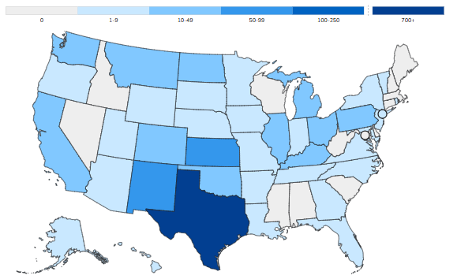
Current State of Measles - 2025
Cases as of July 8, 2025
Measles Cases and Outbreaks | Measles (Rubeola) | CDC

Slide 10
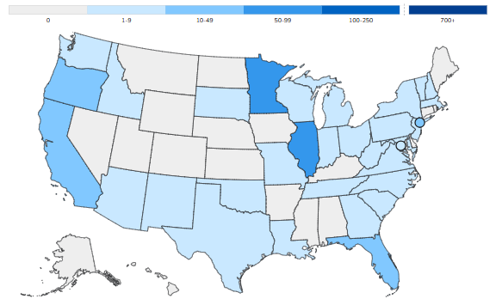
State of Measles - 2024
Measles Cases and Outbreaks | Measles (Rubeola) | CDC

Slide 11
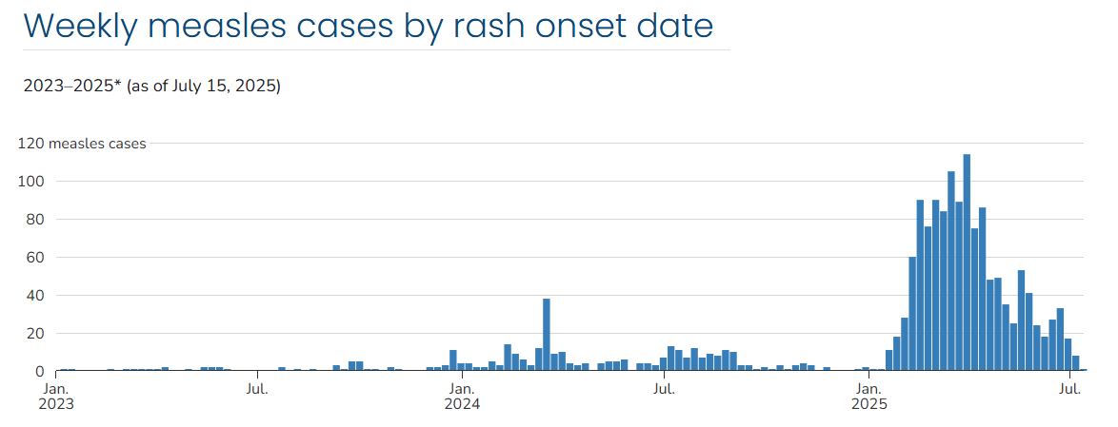
U.S. Measles Cases
January 2023 – July 2025*
*2023–2025 case counts are preliminary and subject to change.
Measles Cases and Outbreaks | Measles (Rubeola) | CDC

Slide 12

September 2024 SC Case
CDC notified SC DPH’s Central Office of potentially exposed individuals on an international flight that were sitting near a confirmed measles case.
Local health department reached out to the individuals and started symptom monitoring.
Case was unvaccinated and developed symptoms.
70+ people were exposed based off the rash onset date.
No secondary cases developed.
CDC performed measles genotyping and determined that the flight index case and our secondary case had the same genotype.

Slide 13

July 2025 SC Case
Case traveled to Canada and was exposed to measles.
Flew to SC outside of contagious period.
Case unvaccinated
Monitoring close contacts

Slide 14
Clinical Case Definition
An acute illness characterized by:
Temperature, greater than or equal to 101ºF; and
Cough, coryza, and conjunctivitis; followed by
Generalized, maculopapular rash lasting 3 or more days

Slide 15
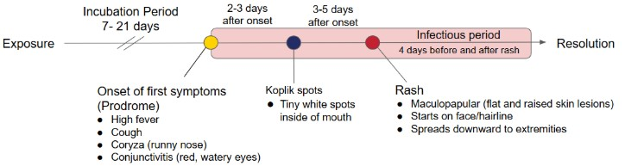
Measles Timeline
Source: Measles – Colorado Department of Public Health & Environment

Slide 16
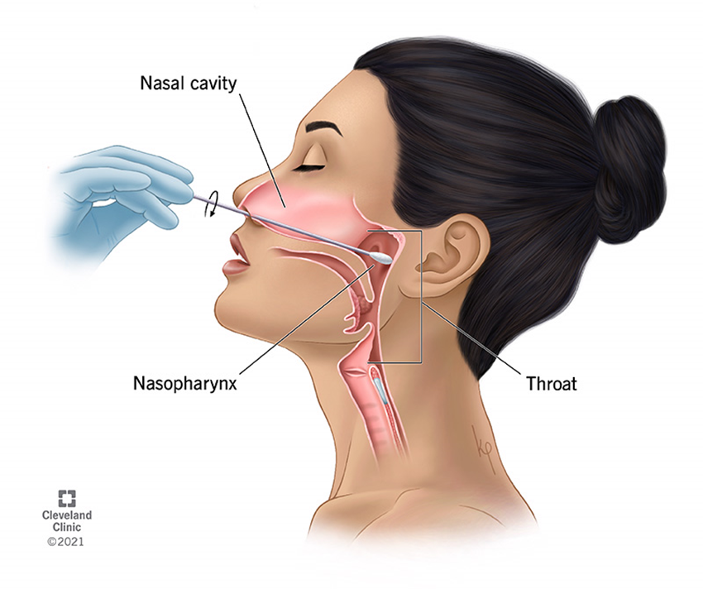
Testing
Preferred: NP Swab for PCR
Testing is available for Measles PCR at SC PHL. This can also be used for a respiratory BIOFire if negative.
Measles IgM
  Testing available through SC PHL. This will be forwarded to CDC for analysis.
Measles Virus Sequencing: Genotyping available through CDC.
Measles IgG: Available at SC PHL for immunity testing.

Slide 17



Measles Diagnostic Testing
Clinical, epidemiologic, and laboratory data should all be considered when diagnosing measles infection
Using serology (IgM) alone to test patients with low pre-test probability of having measles will result in more false positives than true positives
Nasopharyngeal (NP) swab preferred for RT-PCR and serology (IgG)
Notes:
NP swab is preferable for the Public Health Laboratory because it will allow additional testing on Biofire for other rash-causing viruses.
IgM testing only done at CDC. PHL will coordinate specimen shipment if indicated.
IgG serology testing is available for the determination of immunity status and convalescent serum testing.
Collect convalescent specimens 10-30 days after the acute specimen was collected.

Slide 18
Measles RT-PCR Testing
RT-PCR testing is most often performed on NP/OP swabs (urine also)
Specimens are ideally collected within 3 days of rash onset
Proper specimen collection, storage, and processing is critical
rRT-PCR has much higher sensitivity and specificity than serology
CDC and state public health labs can perform rRT-PCR

Slide 19
Mitigation Measures to Reduce Spread
Healthcare Infection Control
PEP Recommendations for Exposed Persons
Ensure HCP have presumptive evidence of immunity
Rapid identification and isolation of patients with known or suspected measles
Adhere to Standard and Airborne Precautions for patients with known or suspected measles
Routinely promoting respiratory hygiene and cough etiquette
Appropriately manage exposed and ill HCP
When possible, it is recommended to give MMR immunization within 72 hours to exposed, susceptible persons.
Postexposure Immune Globulin (IG) for pregnant women without verified immunity, immunosuppressed persons, and infants under 1 year of age who are contacts of a measles case within 6 days of exposure

Slide 20
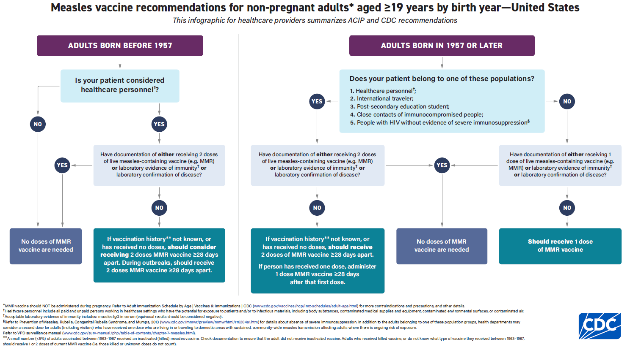

Slide 21


Postexposure Prophylaxis (PEP)
MMR
Should be given within 72 hours (3days) of initial measles exposure
Immunoglobulin
Give within 6 days of initial exposure
Can be given intramuscularly (IM) or intravenously (IVIG)
  IVIG should be prioritized for adults at high risk of severe disease
DO NOT administer MMR vaccine and Immunoglobulin simultaneously. This practice invalidates the vaccine.

Slide 22
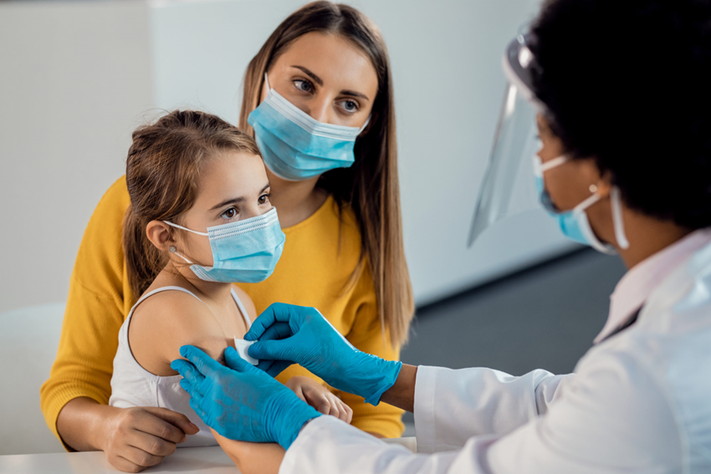
Vaccination Requirements –MMR or MMRV
Children should routinely get 2 doses of MMR vaccine
  First dose at age 12 through15 months
  Second dose at age 4 through 6 years (before school entry)
    Second dose of MMR can be received earlier than 4 through 6 years but has to be at least 28 days after first dose
  Can be administered as MMR or MMRV vaccine
  Second dose of MMRV can be given 3 months after the first dose up to 12 years of age
Source: Routine Measles, Mumps, and Rubella Vaccination |CDC

Slide 23
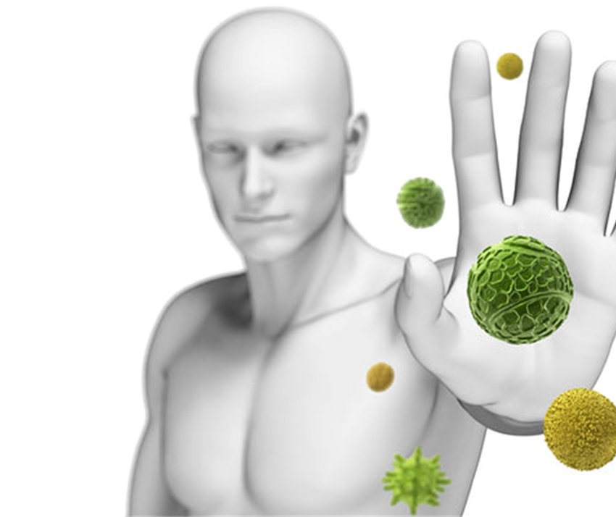
Risk Determination: Immunity
Written documentation of adequate vaccination
Lab evidence, +IgG
  Immunity
  Confirmed disease
Born before 1957-consdier vaccinating HCW who lack lab evidence of immunity

Slide 24
Risk Determination: Exposure
Travel to a location with an outbreak
Commercial air travel domestic or foreign
Exposure to confirmed case

Slide 25
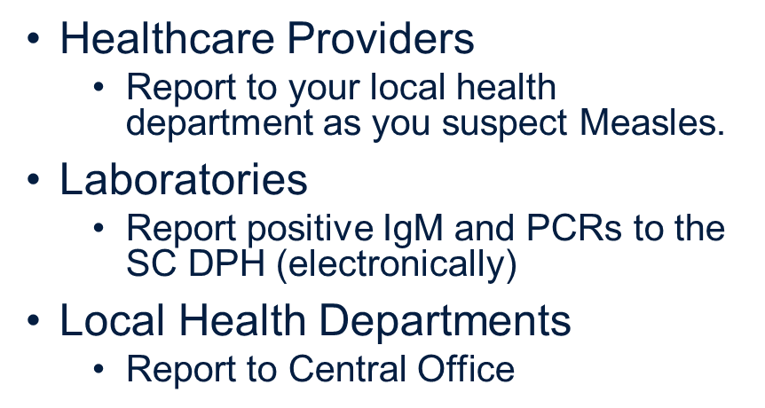

Reporting to DPH

Slide 26
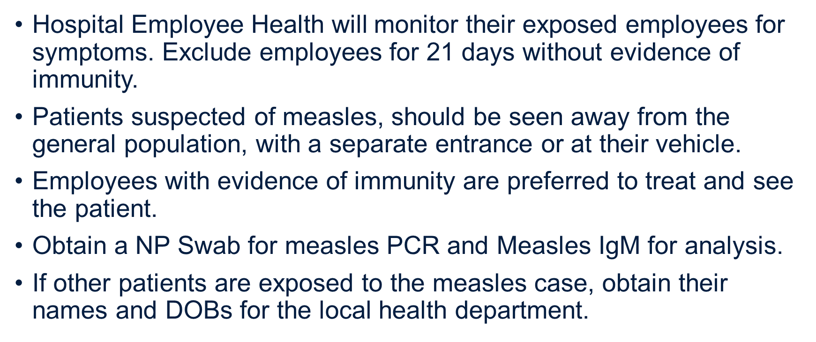
DPH Guidance & Recommendations

Slide 27
Questions?

