Slide 1
Monthly Learning Collaborative April 2024
What is EmPATH and why it is not a crisis stabilization unit

Slide 2
An EmPATH unit is NOT a CSU!
Explaining it All

Slide 3
The Origin of EmPATH
Creating and operating an EmPATH unit is the modern, patient-centric, effective approach to evaluating and treating behavioral emergency patients in hospital settings.
The concept is well over a decade old and was created in response to a national problem faced by most hospital Emergency Departments (ED) – patients with behavioral emergencies were being held for long hours, untreated, waiting for transfer to an inpatient psychiatric facility bed, a situation known as “boarding”.
The idea for EmPATH arose from the recognition that the time spent boarding was not helping these individuals, and in many cases actually making their symptoms worse.

Slide 4
Why can’t we call our EmPATH unit a CSU?
First of all, you can call your EmPATH unit whatever you want, even “Fred”. EmPATH is a "model of care" and doesn’t require you to name it after the model.
For example, you can call your maternity department “New Beginnings”, but it’s still a Labor & Delivery Unit.

Slide 5
Well then, why shouldn’t we call our EmPATH unit a CSU?
CSU does roll easily off the tongue, and sounds nice
CSU usually stands for “Crisis Stabilization Unit”
Problem is, just about wherever you go in the country, a Crisis Stabilization Unit means something different – anything from a drop-in “community” counseling center to a six-month residential detox program – and this can be very confusing
EmPATH (Emergency Psychiatry Assessment, Treatment and Healing Unit) was specifically created to end this confusion, and describe a specific model, and ONLY that specific model.

Slide 6
Simplifying a confusing system
The academic acronym "EmPATH" was specifically created to differentiate this model from other acute care and urgent care behavioral health programs, of which there are many different names, that can frequently mean different things where you are in the USA. The current nomenclature can even be vastly different from one county to a neighboring county!
EmPATH is an academic title well established in the literature for a specific type of program. EmPATH is not copyrighted or licensed , anyone can create an EmPATH unit without needing permission or approval, just like any hospital can have a "Labor and Delivery unit" without needing to pay a copyright holder.
To fit the definition, to be an EmPATH unit, a program must:
Be affiliated with an Emergency Department, usually in a hospital setting;
Treat high-acuity behavioral health patients that would traditionally be boarding in emergency departments
Have prompt access to a psychiatric provider who initiates a treatment plan within minutes of the patient's arrival on the EmPATH unit
Has an "open milieu" where patients are in recliners and are free to move about and engage in activities, as opposed to more traditional psych ERs where patients are confined to specific areas
The EmPATH unit is NOT a location where patients go to wait for an inpatient bed, instead there is active treatment ongoing for up to a set number of hours, and the final decision on inpatient admission vs discharge is not made until a thorough re-assessment is performed after the treatment plan has had ample opportunity to work

Slide 7
A Question of Acuity
The primary difference between EmPATH units and crisis stabilization units (CSUs) is that EmPATH units are for high-acuity patients who would otherwise be in an ED awaiting care.
EmPATH units are an “emergency path” to the most appropriate level of care for patients in a hospital-based emergency setting.
•EmPATH units can more thoroughly evaluate the presenting issue from both medical and psychologic standpoints, and offer a larger array of treatments than a CSU, which typically is more focused on psychotherapy interventions.
Most 'CSU's are great programs but are based 'off hospital grounds' in the community, and so can't accept involuntary patients, or patients with acute substance intoxication/withdrawal, or medical comorbidity.

Slide 8
Many wonderful community crisis stabilization (CSU) programs have been created with the hopes of reducing ED use for psychiatric patients – but while they do excellent work for many types of patients, here’s why these often aren't 'for everybody', and the reason many emergency psychiatry patients still come to the Emergency Departments:
These programs tend to be set up for mild-to-moderate severity patients
They have exclusion algorithms for acute patients, which say ‘send to the ED’ or ‘call 911”
Common Exclusion Criteria for Community Crisis Centers
Patients who are currently agitated/aggressive or history of violence
Patients with profound symptoms of psychosis/disorganization
Patients with severe suicidal ideation or a serious suicide attempt
Patients with active substance/alcohol intoxication or withdrawal
Patients on involuntary status or with active criminal charges
Patients pronounced comorbid medical issues, incl overdose, self-injury
Patients with vital signs abnormalities
Patients with serious developmental disabilities/neurologic issues
Patients who have utilized the crisis program too frequently/recidivists
Patients who refuse indicated medications

Slide 9
A Calming, Comfortable Environment
As seen in
The New Yorker

Slide 10
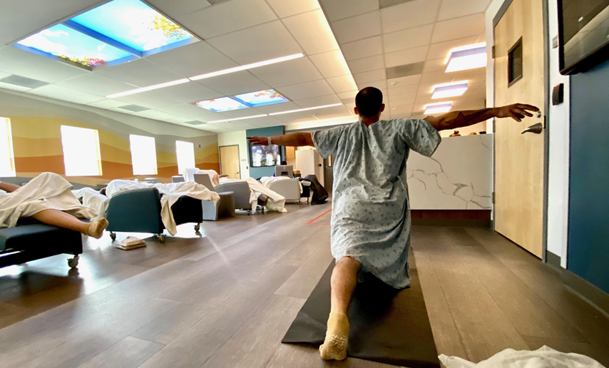
A Feeling of Spaciousness

Slide 11
“The Empath unit’s real innovation is a structural shift in how we think about space and time. We usually consider drugs, devices, and procedures the kinds of medical care that make a difference, but physical spaces can be therapeutic, too.”
-Dhruv Khullar, The New Yorker magazine, July 2023

Slide 12
Important points and clarifications
One of the services that EmPATH units can provide is "crisis stabilization", but that doesn't mean it is a 'crisis stabilization unit" per se. Caesarian Sections are performed in Labor and Delivery units, but that doesn't mean you have to call them Caesarian Section units. There's a difference between an individual specific service provided, and the overall 'service line'.

Slide 13
Important points and clarifications
"Crisis" may even be a term on its way out – and identifying patients in our emergency department as behavioral emergencies or psychiatric emergencies may be more appropriate anyway. In the ED, we don't see a 'heart crisis' or an 'abdominal crisis', we see emergency conditions. If EMTALA says psychiatric emergencies are emergency medical conditions just like heart attacks, shouldn't we use the same terminology? Won't that reduce stigma compared to other medical conditions?
On a recent internal poll, one agency found that over 80% of patients in a crisis facility didn't like the term 'crisis' and wished the program had a different name.

Slide 14
EmPATH Scope of Service
The EmPATH (Emergency Psychiatric Assessment, Treatment & Healing) Unit provides voluntary and involuntary mental health services lasting less than 24 hours to persons (insert your program’s age range here) in a psychiatric emergency due to a mental health condition that requires a timelier response than a regularly scheduled visit to prevent decompensation.
The EmPATH Unit is for rapid mental health evaluation and psychiatric assessment, and provides psychiatric stabilization and treatment, which includes; providing a safe environment and crisis intervention -- which may include therapy, medication treatment and consultation, discharge planning and referral services.

Slide 15
EmPATH Unit Inclusion Criteria
Patients who are 18 years of age and older.
Patients who present as a danger to self, danger to others and/or gravely disabled by virtue of a psychiatric disorder and are in an acute psychiatric crisis.
Patients may be either voluntary or on an involuntary hold
Patients who are medically stable and cleared medically by the Emergency Department provider.
Patients whose vital signs are within wide, yet appropriate ranges:
Patients who are alert and can ambulate or transfer without assistance.
Patients who do not have medical conditions that require screening, such as:
Possibility of an active communicable disease that could be transmitted to other patient, e.g., C.Diff, MRSA/VRE, Influenza, Tb, Scabies/Lice, fever with rash, etc.

Slide 16
EmPATH Unit Exclusion Criteria
No lines or Devices
Intensive wound care.
Primary diagnosis or developmental/intellectual disability only (not to be confused with those who have an acute psychiatric condition with co-occurring issues including a developmental/intellectual disability). Should be reviewed on a case-by-case basis.
Primary diagnosis or organic brain syndrome (i.e. head injuries, dementia).
Non ambulatory or unable to assist with transfer
Medically unstable substance withdrawal requiring intravenous treatment.

Slide 17
Questions?

